Slide 1
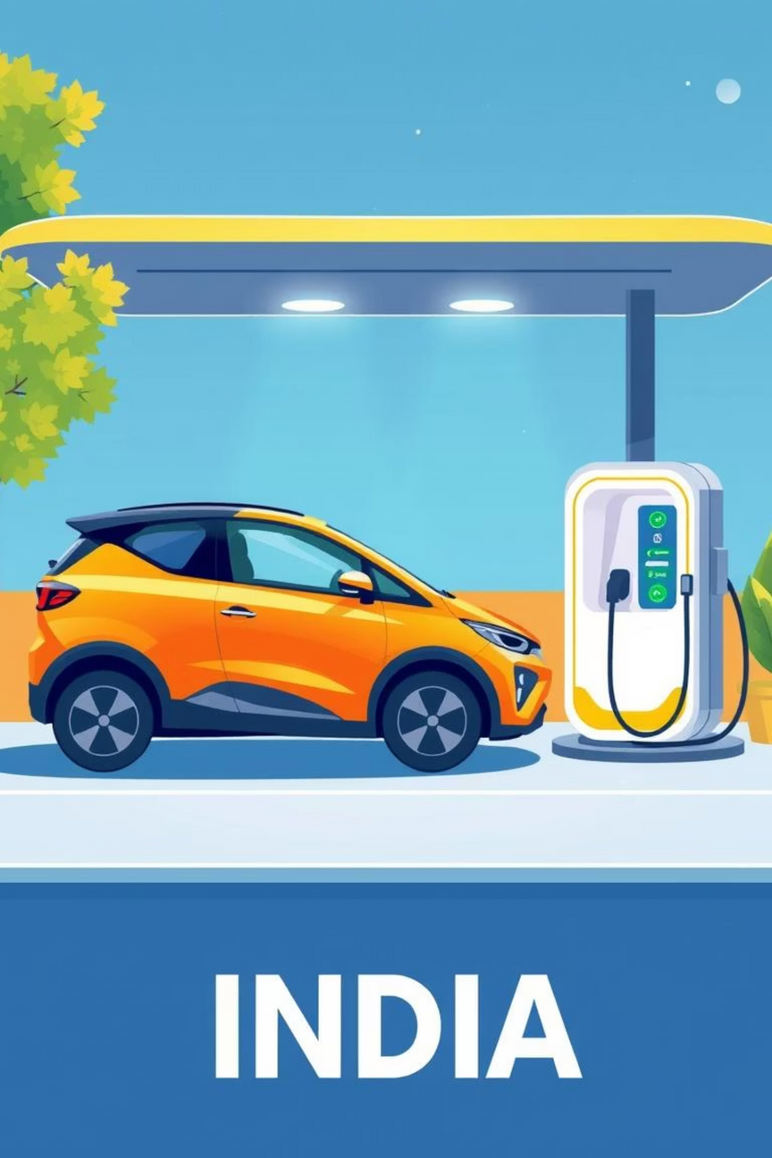
Predictive Analysis of Electric Vehicle Sales Across Indian States
Using Machine Learning & Data Analytics
MANSI RAMDAS GAWADE
Ramrao Adik Institute of Technology (DY PATIL UNIVERSITY)

Slide 2
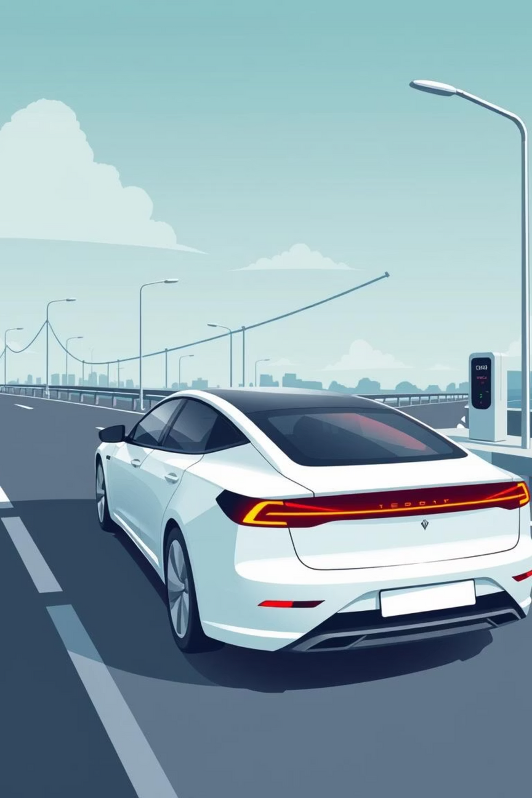
Introduction: The Rise of EVs in India
Electric Vehicles (EVs) are gaining global importance, with India emerging as a key market due to policy support like the FAME scheme. This project aims to provide data-driven insights at the state level, analyzing trends and predicting EV sales using machine learning.

Slide 3
Dataset Overview
Source
Clean Mobility Shift (public data)
Time Frame
2014–2024
Coverage
36 states/UTs, multiple vehicle classes & types
Key Features
Year, Month, Date, State, Vehicle Class, Category, Type, Sales Quantity
Data Size
96,845 records, clean with no missing/duplicate data

Slide 4
Data Preprocessing Steps
01
02
Data Cleansing
Data Type Conversion
Handled missing and duplicate values to ensure data integrity.
Converted 'Year' to integer, 'Date' to datetime, and categorical fields appropriately.
03
04
Feature Engineering
One-Hot Encoding
Extracted 'month' and 'day' from the 'Date' field for richer analysis.
Applied one-hot encoding to categorical features for model compatibility.

Slide 5
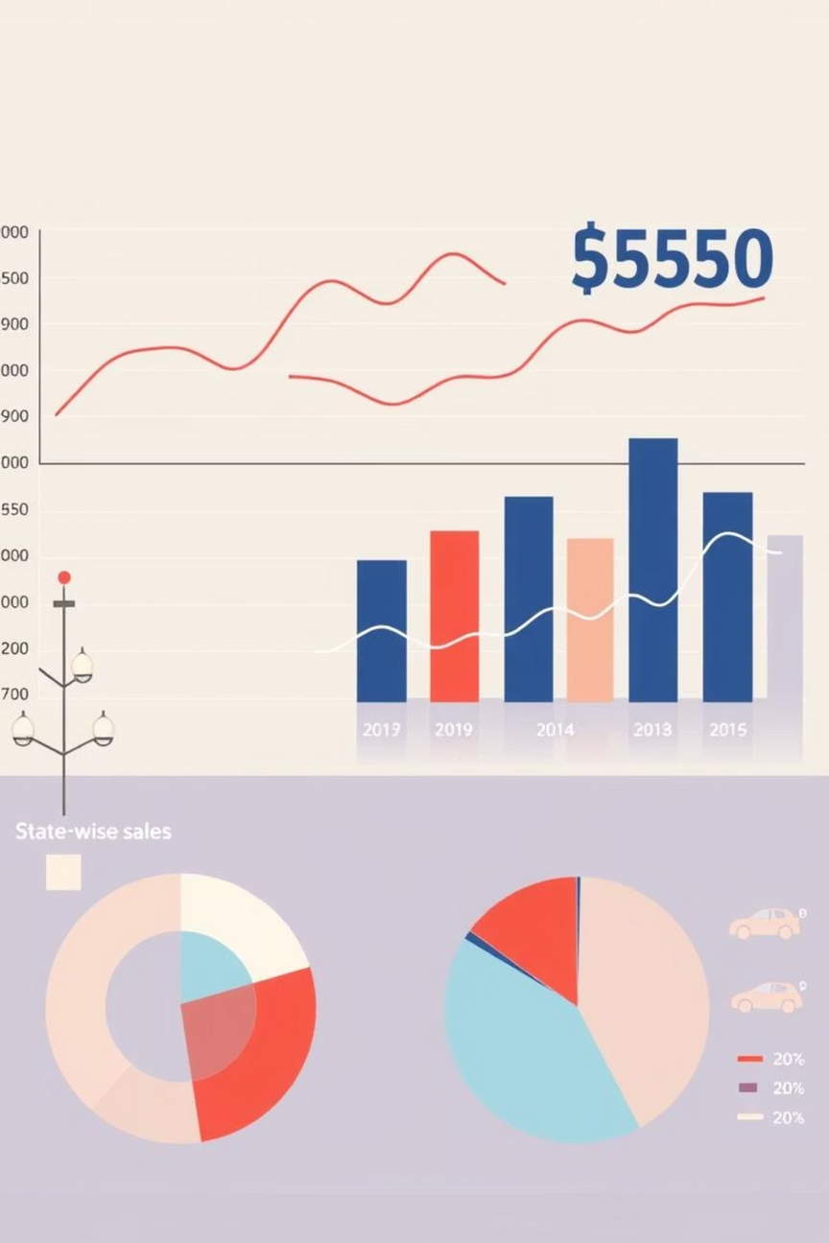
Exploratory Data Analysis (EDA)
Key Trends
Vehicle Segmentation
Steady growth until 2019, sharp rise post-2020.
Dominated by 2-wheelers and passenger vehicles.
Periodic sales peaks align with festivals and policies.
Commercial vehicles show emerging potential.
Maharashtra, Karnataka, Tamil Nadu lead the market.

Slide 6

Modeling Approach: Random Forest Regressor
Algorithm Choice
Implementation Details
Random Forest Regressor was selected for its robustness, ability to handle mixed data types, and insights into feature importance.
Data Split: 80% training, 20% testing.
Features: Date features + one-hot encoded categorical variables.
Target: EV sales quantity.

Slide 7
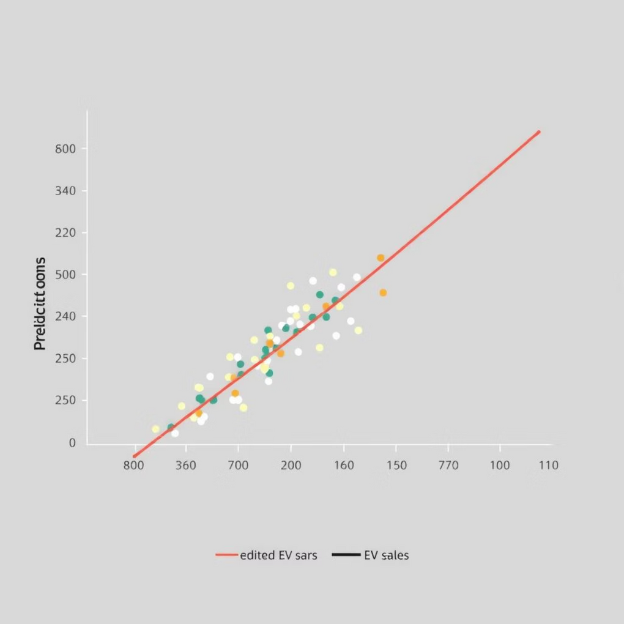
Model Performance
RMSE: ~130 units
This indicates good accuracy, especially considering the wide sales range (0–20,000 units).
The scatter plot visually confirms a strong correlation between predicted and actual sales, with minimal outliers.

Slide 8
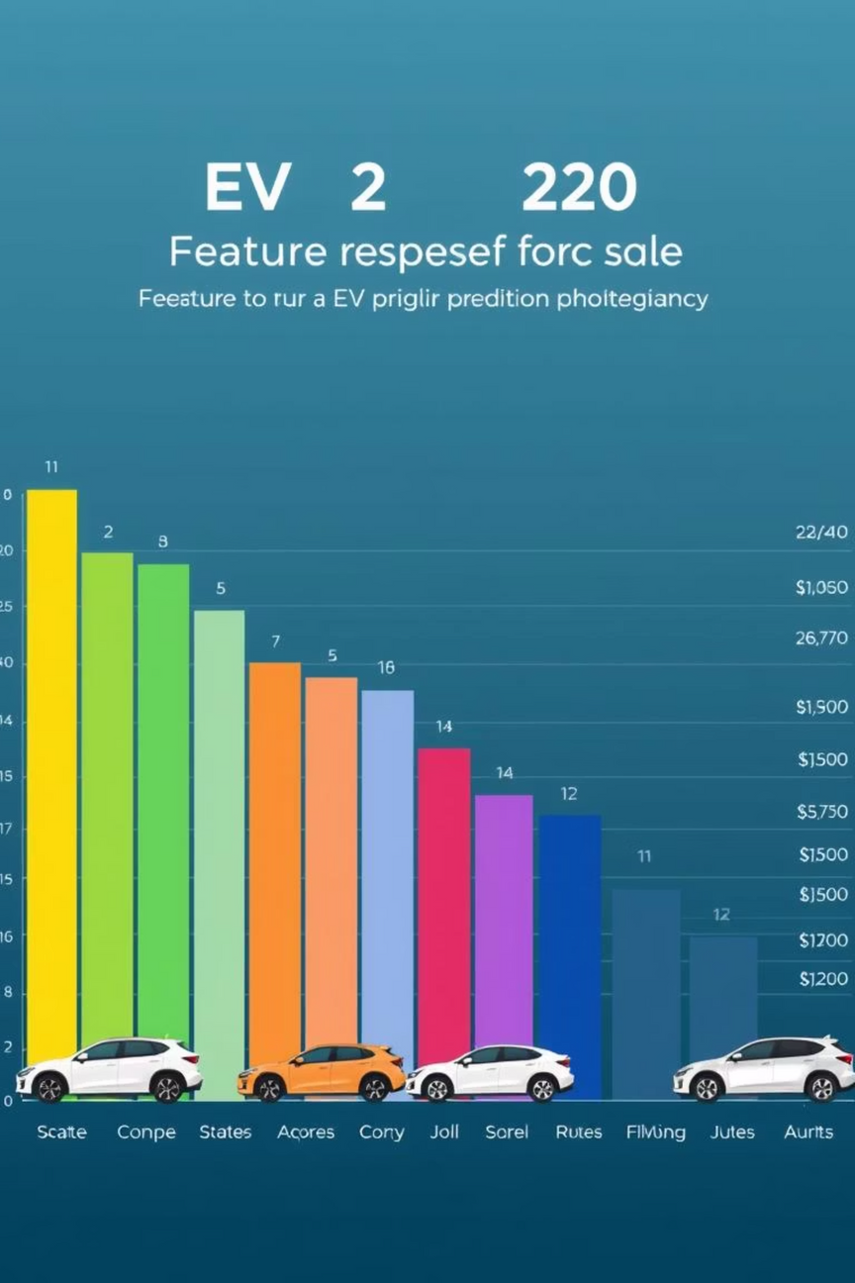
Feature Importance
The model identified specific states and vehicle categories as top predictors, highlighting that geographic location and product segment are key drivers of EV sales.
These insights are crucial for effectively targeting marketing efforts and policy initiatives.

Slide 9
Key Insights & Recommendations
Market Growth
Targeted Focus
Driven by favorable policies and consumer adoption post-2020.
Prioritize high-performing states (Maharashtra, Karnataka, Tamil Nadu) and key vehicle segments (2-wheelers, passenger vehicles).
Seasonal Leverage
Infrastructure & Policy
Utilize seasonal trends for inventory management and sales campaigns.
Focus on these areas in emerging states to expand market reach.

Slide 10

Conclusion & Future Work
Successfully modeled EV sales using ML on 2014–2024 data.
Data-driven insights empower stakeholders to optimize strategies.
Model performance is adequate for forecasting and decision-making.
Future work includes incorporating socio-economic data and advanced models for enhanced predictions.

